Slide 1


CSS
Cascading Style Sheets
Mr. A. Rozario
B. Voc. (SD & SA)

Slide 2
CSS
CSS stands for Cascading Style Sheets
Styles define How to display HTML elements
CSS Saves a Lot of Work!
CSS defines How HTML elements are to be displayed
Styles are normally saved in external .css files. External style sheets enable you to change the appearance and layout of all the pages in a Web site, just by editing one single file!

Slide 3
Understanding Style Rules
A Style Rule is composed of two parts: a selector and a declaration.
Selector
Declaration
P{color: red;}
The Selector indicates the element to which the rule is applied.
The Declaration determines the property values of a selector.

Slide 4
Understanding Style Rules
The Declaration determines the property values of a selector.
The Value expresses specification of a property, such as red for color, arial for font family, 12 pt for font-size, and is followed by a semicolon (;).
Property
Value
P{color: red;}

Slide 5
CSS
CSS declarations always ends with a semicolon, and declaration groups are surrounded by curly brackets:
  p {color:red;text-align:center;}To make the CSS more readable, you can put one declaration on each line, like this:
    Example
      p{color:red; text-align:center; }
CSS Comments
  A CSS comment begins with "/*", and ends with "*/", like this:
  /*This is a comment*/
    p{ text-align:center;
    /*This is another comment*/
    color:black;
    font-family:arial;
    }

Slide 6
CSS Syntax: Selector Strings
Element Type Selector / Single element type:
Group Selector / Multiple element types:
Universal Selector / All element types:
Id Selectors / Specific elements by id:
Class Selectors
  .p {font-weight: bold;}

Slide 7
The id and class Selectors
In addition to setting a style for a HTML element, CSS allows you to specify your own selectors called "id" and "class".
The id Selector
The id selector is used to specify a style for a single, unique element.
The id selector uses the id attribute of the HTML element, and is defined with a "#".
The style rule below will be applied to the element with id="para":
Example
  #para {text-align:center; color:red;}

Slide 8
The id and class Selectors
The class Selector
The class selector is used to specify a style for a group of elements. Unlike the id selector, the class selector is most often used on several elements.
This allows you to set a particular style for any HTML elements with the same class.
The class selector uses the HTML class attribute, and is defined with a "."
In the example below, all HTML elements with class="center" will be center-aligned:
Example
.center
{ text-align:center; }
  In the example below, all p elements with class="center" will be centeraligned:
Example
  p.center {text-align:center;}

Slide 9
Three Ways to Insert CSS
Inline style
Internal / Embedded style sheet
External style sheet

Slide 10

Inline Styles
<p style="color:red;margin-left:20px">This is a paragraph.</p>
Multiple Style Sheets
If some properties have been set for the same selector in different style sheets, the values will be inherited from the more specific style sheet.
For example, an external style sheet has these properties for the h3 selector:
  h3
  {
  color:red; text-align:left; font-size: 8pt;
  }
And an internal style sheet has these properties for the h3 selector:
  h3
  {
  text-align:right; font-size:20pt;
  }

Slide 11
Inline Styles
If the page with the internal style sheet also links to the external style sheet the properties for h3 will be:
color: red;
text-align: right;
font-size: 20pt;
The color is inherited from the external style sheet and the text-alignment and the font-size is replaced by the internal style sheet.

Slide 12
Internal Style Sheet
An internal style sheet should be used when a single document has a unique style.
  <head>
    <style type="text/css">
      hr {color:red;}
      p {margin-left:20px;}
      body {background-image:url("images/back40.gif");}
    </style>
  </head>

Slide 13
External Style Sheet
An external style sheet is ideal when the style is applied to many pages. With an external style sheet, you can change the look of an entire Web site by changing one file. Each page must link to the style sheet using the <link> tag. The <link> tag goes inside the head tag
section:
  <head>
  <link rel="stylesheet" type="text/css" href="mystyle.css" />
  </head>
An external style sheet can be written in any text editor. The file should not contain any html tags. Your style sheet should be saved with a .css extension. An example of a style sheet file is shown below:
hr {color:red;}
p {margin-left:20px;}
body {background-image:url("images/back40.gif");}

Slide 14
CSS Text
Setting the text color
Property - Value
Color: rgb|hexa|red;
• Alignment of text
pro
Text-align: center|left|right|justify;
• Indentation of text
• Decoration of text
• Sets the spacing between characters
• Sets the spacing between words
• Sets the spacing between lines of text
• Preserving white-space and line breaks
• Text wrapping inside an element
• Vertical alignment of an image inside text

Slide 15
CSS Text Formatting

Slide 16
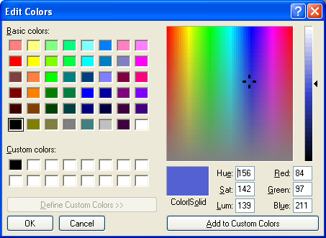
CSS Text - Color
Font color specified by color property
Two primary ways of specifying colors:
Color name: black, gray, silver, white, red, lime, blue, yellow, aqua, fuchsia, maroon, green, navy, olive, teal, purple
red/green/blue (RGB) values

Slide 17
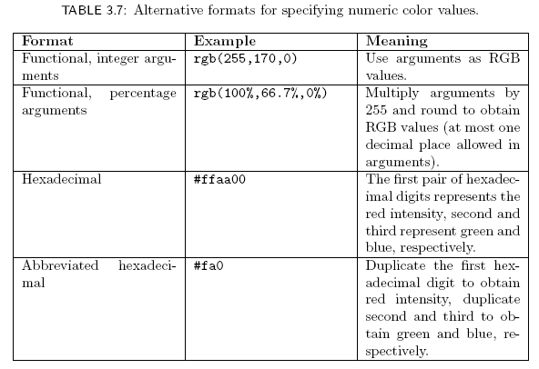
CSS Text - Color

Slide 18
CSS FONT
Sets the font of a text
Sets the size of the font
Sets the style of the font
Sets the variant of the font
Sets the boldness of the font
Setting the all font properties in a single declaration - The font shorthand property

Slide 19
FONT Properties
The font family of a text is set with the font-family property.
The font-family property should hold several font names as a "fallback" system. If the browser does not support the first font, it tries the next font.
p{font-family:"Times New Roman", Times, serif;}
A font family is a collection of related fonts (typically differ in size, weight, etc.)

Slide 20
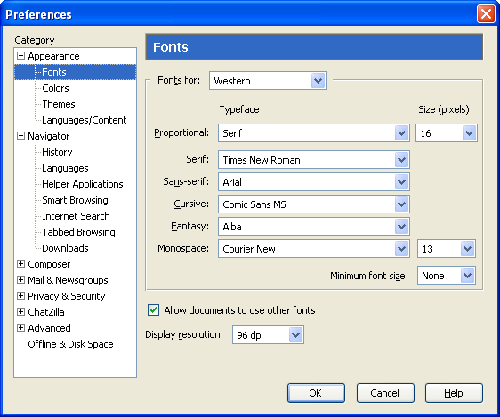
FONT Properties
generic
fonts are
system-
specific

Slide 21
FONT Properties
Set Font Size With Em
To avoid the resizing problem with Internet Explorer, many developers use em instead of pixels.
The em size unit is recommended by the W3C.
1em is equal to the current font size. The default text size in browsers is 16px. So, the default size of 1em is 16px.
The size can be calculated from pixels to em using this formula: pixels/16=em
Example
  h1 {font-size:2.5em;} /* 40px/16=2.5em */
  h2 {font-size:1.875em;} /* 30px/16=1.875em */
  p {font-size:0.875em;} /* 14px/16=0.875em */

Slide 22
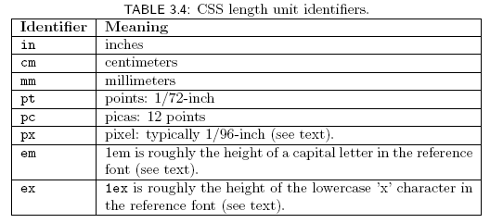
FONT Properties
Many properties, such as font-size, have a value that is a CSS length
All CSS length values except 0 need units

Slide 23
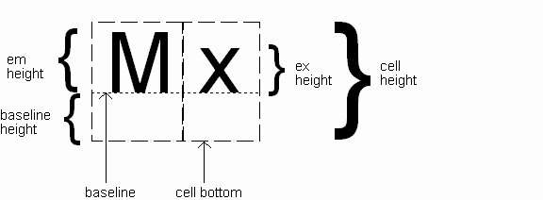
FONT Properties
Computed value
of font-size
property
Other ways to specify value for font-size:
  Percentage (of parent font-size)
  Absolute size keyword: xx-small, x-small, small, medium (initial value), large,
  x-large, xx-large
    User agent specific; should differ by ~ 20%
  Relative size keyword: smaller, larger
    Relative to parent element’s font

Slide 24
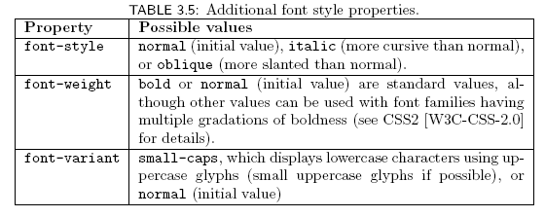
FONT Properties

Slide 25

FONT Properties
Text is rendered using line boxes
Height of line box given by line-height
  Initial value: normal (i.e., cell height; relationship with em height is font-specific)
  Other values (following are equivalent):

Slide 26
FONT Properties
font shortcut property:
Initial values used if no value specified in font
property list (that is, potentially reset)

Slide 27
FONT Properties
font shortcut property:
specifying line-height (here, twice cell height)
any order
size and family required,
order-dependent

Slide 28
CSS LINKS
Style different states of a link
Remove the default underline from hyperlinks
Remove the dotted outline from hyperlinks
Create link boxes
Image rollover

Slide 29
CSS LINKS
Links can be style with any CSS property (e.g. color, font-family, background-color). Special for links are that they can be styled differently depending on what state they are in.
The four links states are:
  a:link - a normal, unvisited link
  a:visited - a link the user has visited
  a:hover - a link when the user mouse over it
  a:active - a link the moment it is clicked

Slide 30
CSS LINKS
Example
  a:link {color:#FF0000;} /* unvisited link */
  a:visited {color:#00FF00;} /* visited link */
  a:hover {color:#FF00FF;} /* mouse over link */
  a:active {color:#0000FF;} /* selected link */
    a:link {text-decoration:none;}
    a:visited {text-decoration:none;}
    a:hover {text-decoration:underline;}
    a:active {text-decoration:underline;}
      a:link {background-color:#B2FF99;}
      a:visited {background-color:#FFFF85;}
      a:hover {background-color:#FF704D;}
      a:active {background-color:#FF704D;}

Slide 31
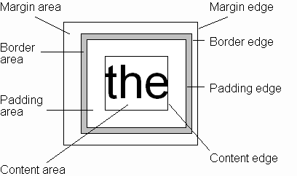
CSS Box Model
Every rendered element occupies a box:

Slide 32
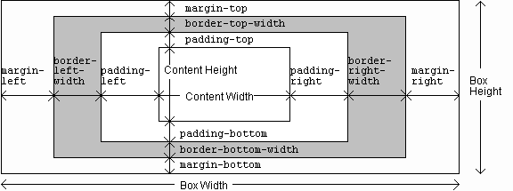
CSS Box Model

Slide 33
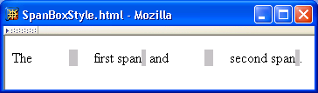
CSS Box Model

Slide 34
CSS Box Model

Slide 35
CSS Box Model

Slide 36
Thank You

